Slide 1
Python and C++
A love affair
Magnus Österlind (magnus@dooz.se)

Slide 2
Overview
Introduction (a play in two acts)
The epiphany
Combining C++ and Python
What I’ve done (demo!)
How it works
The End

Slide 3
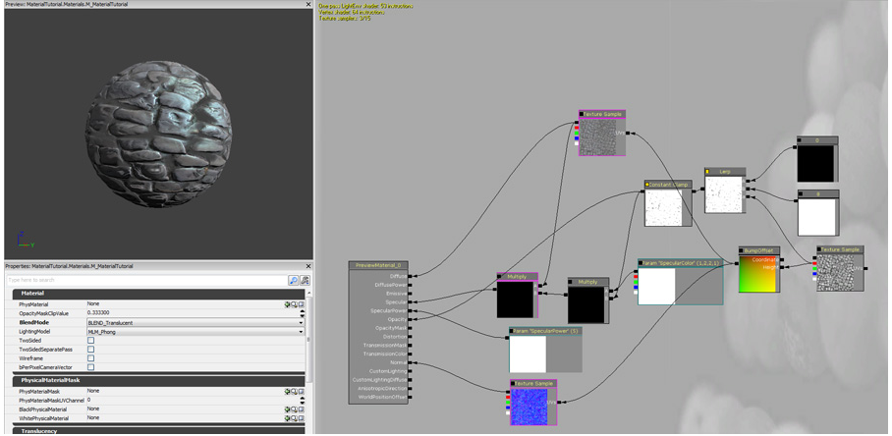
Introduction, act 1 (1/2)
I’ve always wanted to try out procedural texture generation
Notes:
This is a picture of Unreal Material Editor from the Unreal Engine, a 3D-engine that powers many of the biggest selling games today. I goes for around $1 million per license. This is probably the goal for everyone who starts writing a texture generator.

Slide 4
Introduction, act 1 (2/2)
So I start with trying to create an editor
And I end with trying to create an editor
I’ve pretty much done this anually for the past 10 years (I wish I was joking..)
This year I finally realized: Coding GUIs isn’t isn’t really that fun!
Unless you get paid for it! (I want to keep my day job!)
What I’m after is the instant feedback loop, and I can get this by writing logic in Python, and instantly reloading and rerunning the script when it changes.
Notes:
So, the basic problem is that it takes a massive amount of time to get a user friendly (and working!) GUI together, and if you’re working on something yourself (or with other people that can write code), you’re just adding an extra layer of complextiy that has to mimic how the underlying code works, with respec to types etc.
I could get (almost) the same effect with instant reloading. Good enough for me, and allowed me to concentrate on what I thought was fun.

Slide 5
Introduction, act 2 (1/3)
(Disclaimer: this is my own interpretation)
Two schools of combining C++ and Python (or language A and language B).
Non-intrusive
You have clear boundaries between A and B, and only primitive types are passed back and forth. C-style interface.
Intrusive
The languages have a deeper knowledge of each other’s structures, can create object across language boundaries etc.
Notes:
Non-intrusive just feels more right, as it forces you to think about your abstractions, and not just end up with a big ball of mud where everyone knows everyone. It’s more black-boxy, where you have this concrete function that you call, and it (might) give you back a result. It also feels like the right solution if you want to be able to interface with other languages.
But for my project, an intrusive approach fit very well, and lead to some fun stuff.

Slide 6
Introduction, act 2 (2/3)
Intrusive C++ and Python
I’m using Boost::Python
I’ve used a lot of Boost before, and Boost::Python was easy to get running (and not much extra typing)
Swig is very popular too, but I haven’t tested it.
Notes:
Boost is one of the biggest free C++ libraries, and contains lots of functionality that you might (or might not) need when coding C++. Lots of algorithms, extensions to the standard STL-containers, and, of course, Boost::Python. Not available for Python 3.0 yet. There was a Google Summer of Code project, but I don’t know how far they got.

Slide 7
Introduction, act 2 (3/3)
struct D3DXCOLOR
{
float a, r, g, b;
};
void single_color(const D3DXCOLOR& col, Texture* t);
BOOST_PYTHON_MODULE(texture_ext)
{
class_<D3DXCOLOR>("Color", init<float, float, float, float>())
.add_property("r", &D3DXCOLOR::r)
.add_property("g", &D3DXCOLOR::g)
.add_property("b", &D3DXCOLOR::b)
.add_property("a", &D3DXCOLOR::a)
;
def("single_color", single_color);
}
import texture_ext as t
red = t.Color(1,0,0,0)
black = t.Color(0,0,0,0)
yellow = t.Color(1,1,0,0)
red.r = 0.5
Notes:
This is an example of what the C++ code looks like that exposes some objects to the Python code. There is a lot of template magic going on under the hood that I haven’t dug into at all.
So, this exposes a color structure from C++ to Python, with a ctor and 4 properties, and a function called single_color.
What’s nice here is that the types of the function arguments are automatically deduced, so you don’t have to worry about updating this if you change the arguments in your code.
I focus on writing the actual pixel processing in C++, and the glue in Python. This has a nice side effect of making serialization a non-issue!

Slide 8
What I’ve done
Demo time!
Notes:
Ok, realtime demos as scary, but anyway:
import texture_ext as t
red = t.Color(0.5,0,0,0)
yellow = t.Color(1,1,0,0)
o = t.Texture(512, 512)
t.noise(0.45, 0.45, o)
o2 = t.Texture(512, 512)
t.remap(o, red, yellow, o2)
o3 = t.Texture(512, 512)
t.radial(100, 200, o3)
o4 = t.Texture(512, 512)
t.modulate(o2, o3, o4 )
I really need to be able to pass the same input texture as output texture..

Slide 9
How it works
C++ Main App
Texture
Python script
Notes:
Please excuse my Powerpoint skillz!
Ok, the C++ application uses a Windows API function that noticies it when a file changes (ReadDirectoryChangesW). That file is the Python script. When the script has changed on disk, it’s loaded and run.
To get something to update visually, what I’ve done is made the Texture objects register (and unregister) themselves in their constructors (and destructors), so the C++ application knows which textures exist. Drawing then simply because a case of traversing this list. This isn’t without problems though, as you can’t have texture objects in functions, as this will lead to local scoping, and they will be removed when the function exists (this was an interesting way to see scoping in action!)
You can also click on a thumbnail, and it will set that texture as selected, and that texture is drawn at full resolution in the big window.

Slide 10
The End
Plans for the future: more texture operations, and try something like this for 3d-models.
The code is available at: http://github.com/mrdooz/TextureTjong
Thank you!

